Slide 1


Slide 2
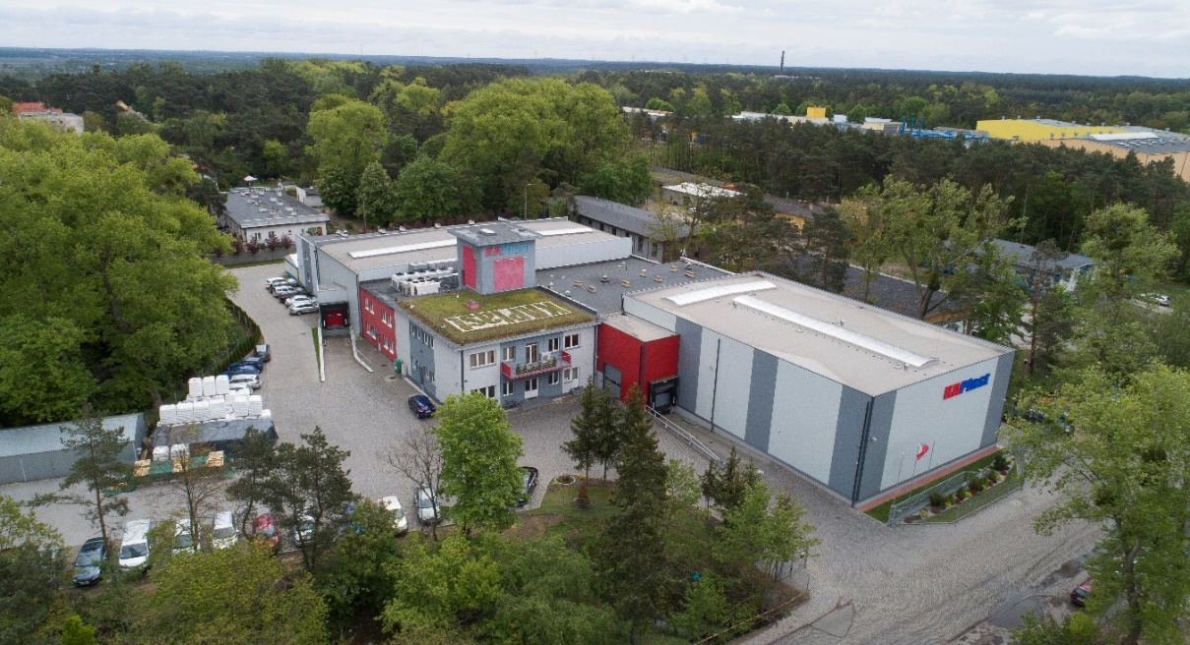
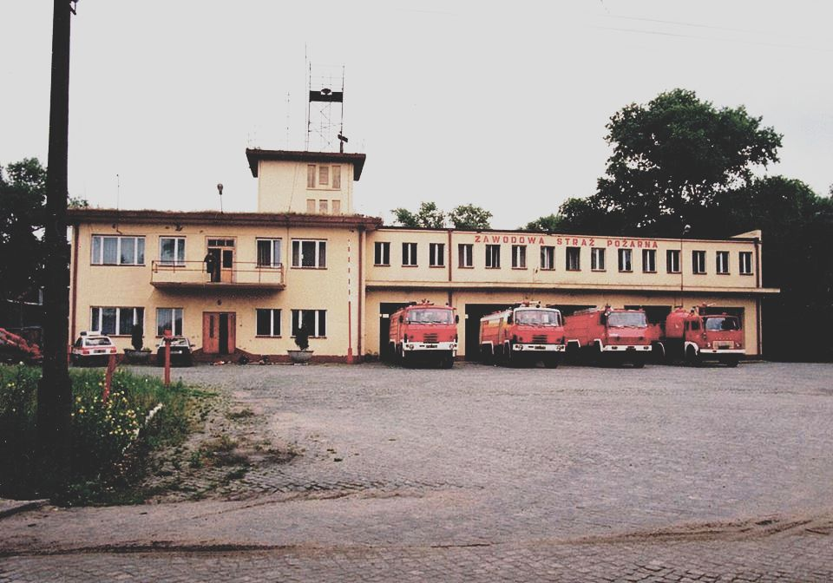
About Us

Slide 3
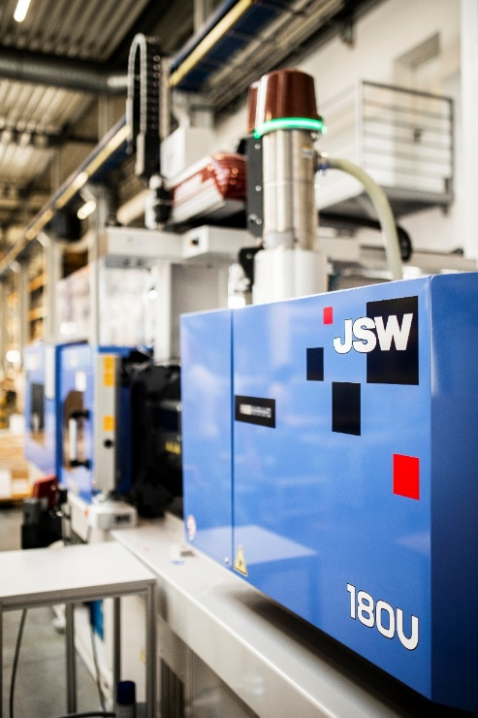
Basic information
Private company founded in 2003.
Modern machine park.
Organic development strategy.
Complex customer service.
High level of competence, experience and production capabilities.
ISO 9001:2015 and IATF 16949:2016

Slide 4
Location
Convenient location in the eastern industrial zone of Bydgoszcz.
Easy access to the A1 and A2 motorways.
ISO 9001:2015 and IATF 16949:2016

Slide 5
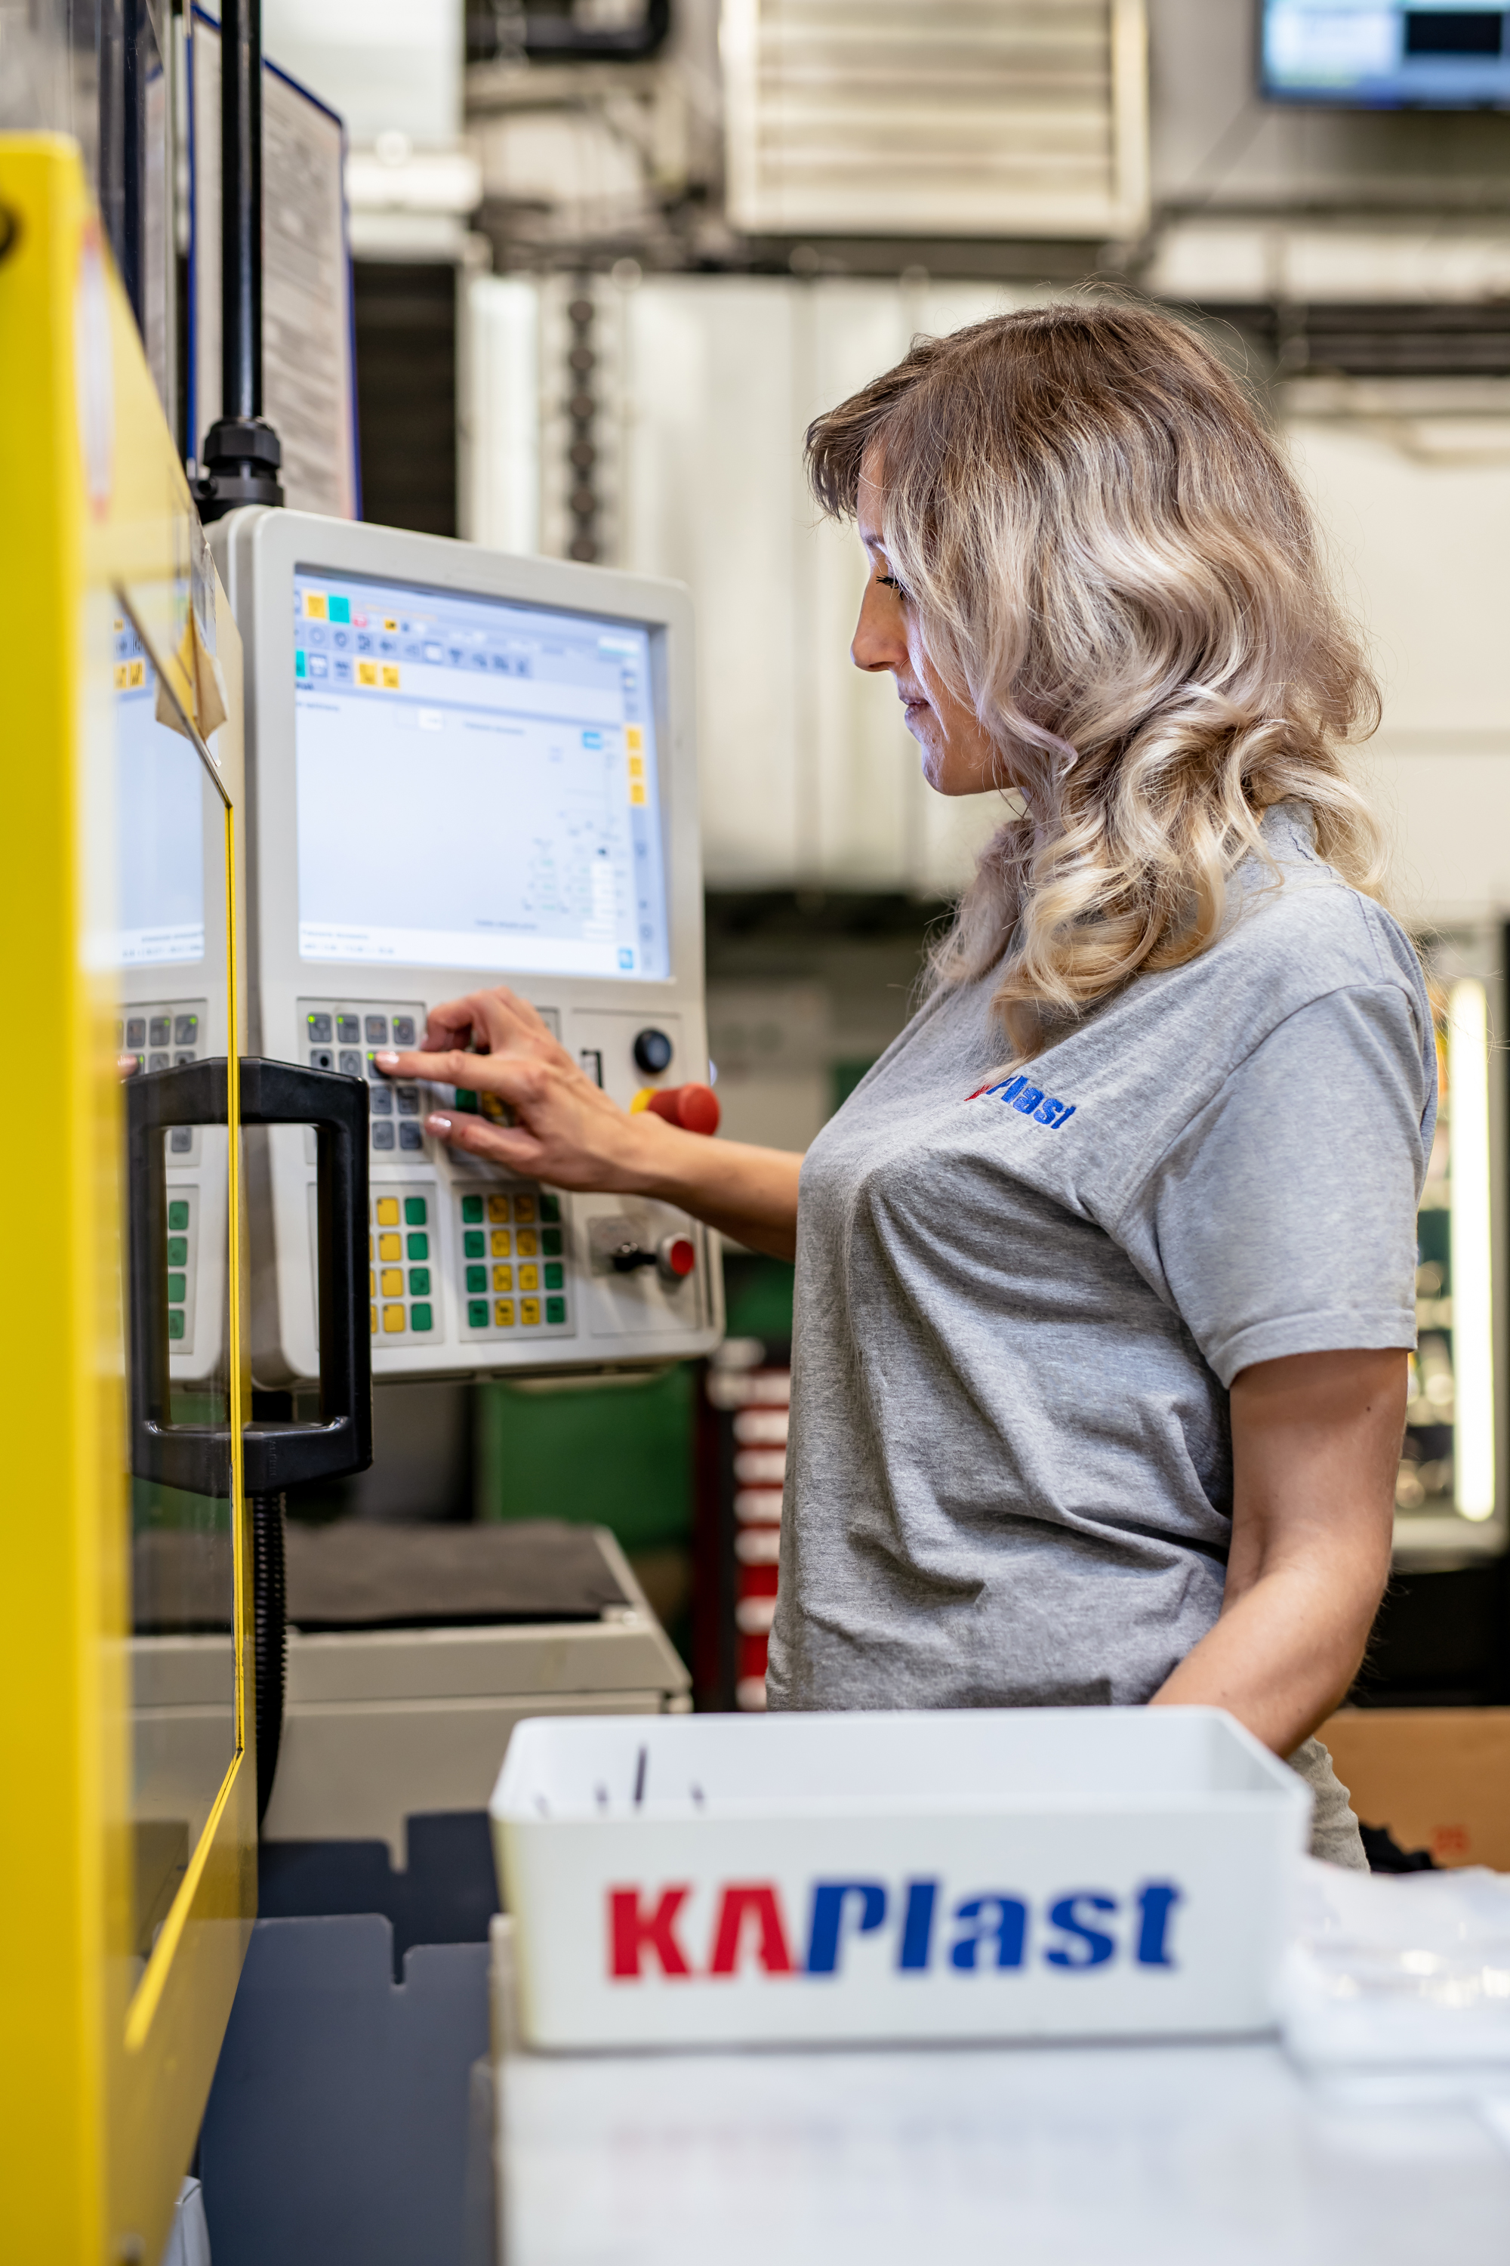
About us
15.03.2004 – start of serial production.
We work in a team of approx. 90
people
20 injection molding machines.
Multi-component injection technology.
Gas injection technology.
ISO 9001:2015 and IATF 16949:2016 certificates.

Slide 6
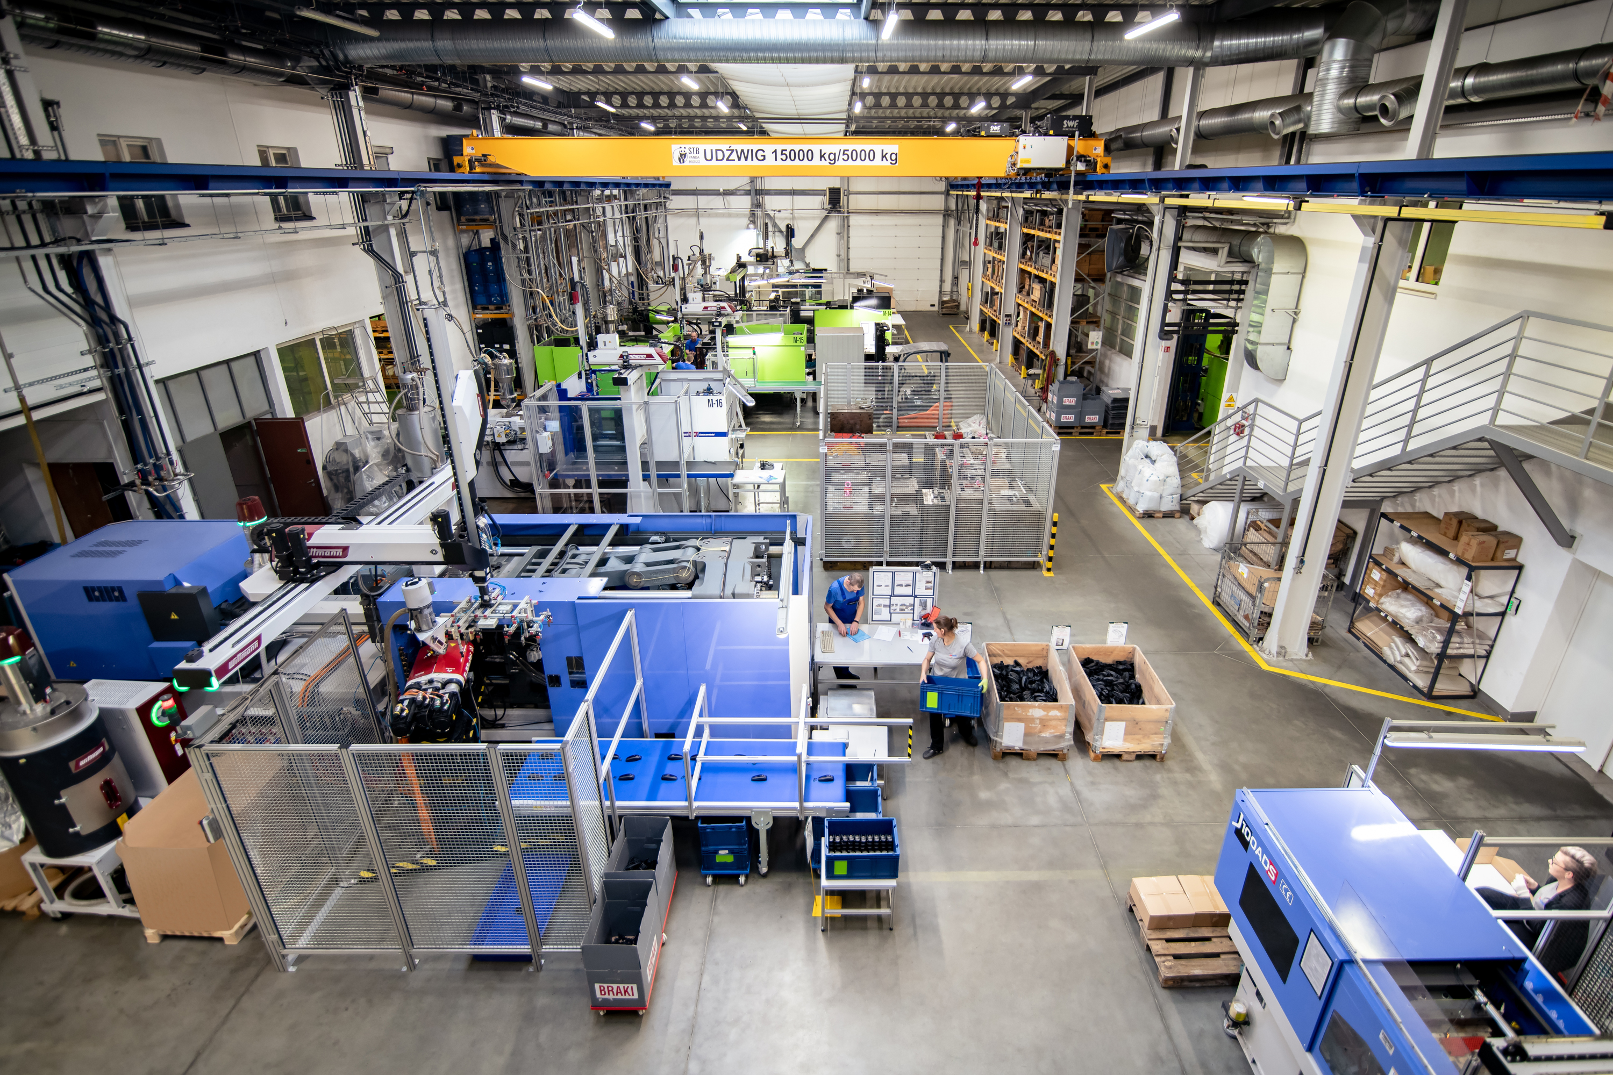
Machine Park
Modern injection molding machines with a clamping force from 25t to 800t.
Arburg, Battenfeld, Engel and JSW injection molding machines:
25T(2x), 45T, 50T(2x), 60T, 80T, 100T, 110T, 120T(2x), 150T, 200T, 220T, 240T, 300T, 450T(2x), 500T, 800T.
ISO 9001:2015 and IATF 16949:2016

Slide 7
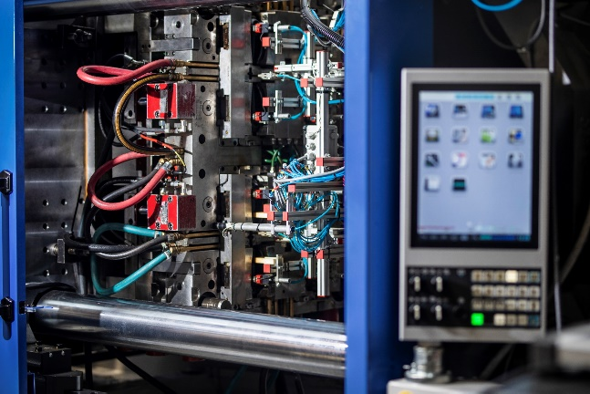
Core competencies
We specialize in the production of technical parts for the automotive, electrical, energy, heating, lighting, tourism, toy, armaments, household appliances and other industries.
Multi-component details.
ISO 9001:2015 and IATF 16949:2016

Slide 8
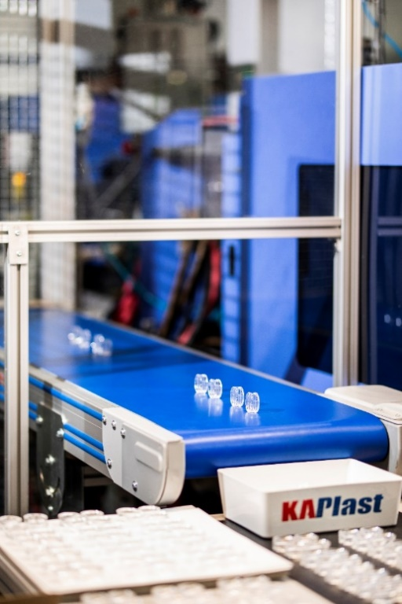
Production
We cooperate with well-known international companies and market leaders from Poland, Germany, Sweden, Belgium, UK, Italy, USA, Canada and Brazil.
Long-term contracts.
Work system in 3 shifts, 5 or 7 days a week.
Materials: PA, PA-GF, PS, PP, PC, POM, SAN, ABS and others.
Injection volume from 20 to 4500 (cm3).
ISO 9001:2015 and IATF 16949:2016

Slide 9
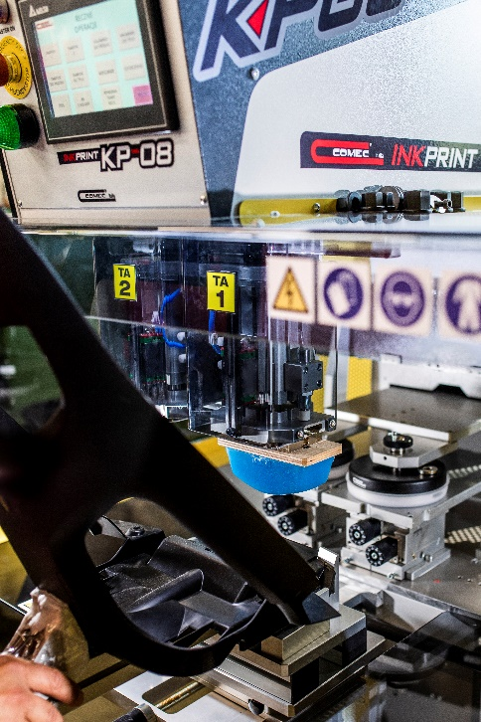
Additional services
Pad printing.
Silkscreen.
Assembly of finished products.
Chrome details.
We are at the stage of implementing ultrasonic welding.
Building new tools
ISO 9001:2015 and IATF 16949:2016

Slide 10
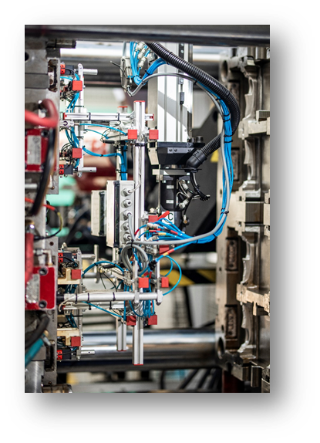
Maintenance department
Ultrasonic cleaners for moulds.
Dry ice blasting.
Technical assistance.
Cleaning the cooling system.
Injection mold cleaning laser.
ISO 9001:2015 and IATF 16949:2016

Slide 11
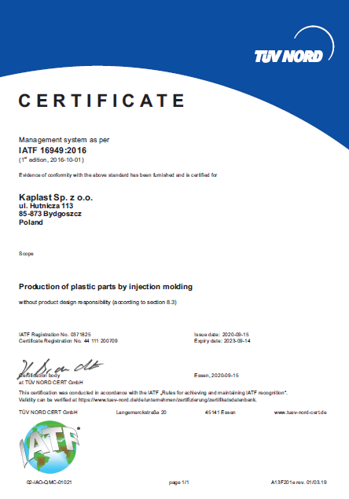
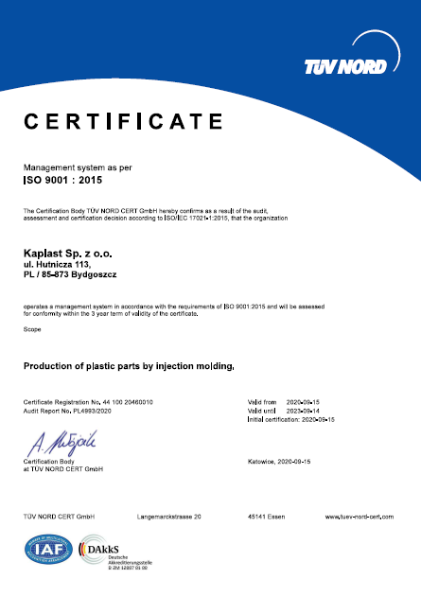
Quality control department
We work in accordance with the ISO 9001:2015 and IATF 16949:2009 standards.
Team
Quality engineer responsible for implementing quality standards.
Quality manager responsible for measurements.
Design engineer responsible for mold changes and drawings.
Experienced quality control team.
ISO 9001:2015 and IATF 16949:2016

Slide 12
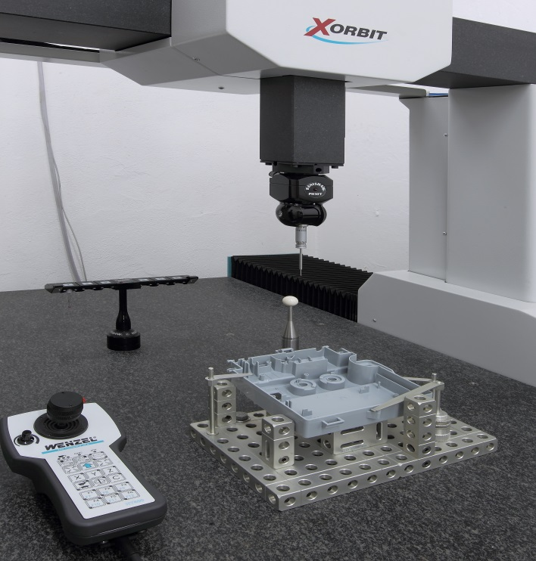
Quality control department
Our QC department is equipped with a computer controlled 3D measuring machine from Wenzel Xorbit XO55.
Measurement range : 500(x)x700(y)x500(z).
Measurement of parts of various shapes.
The device uses a graphical, interactive measurement system based on CAD files.
ISO 9001:2015 and IATF 16949:2016

Slide 13
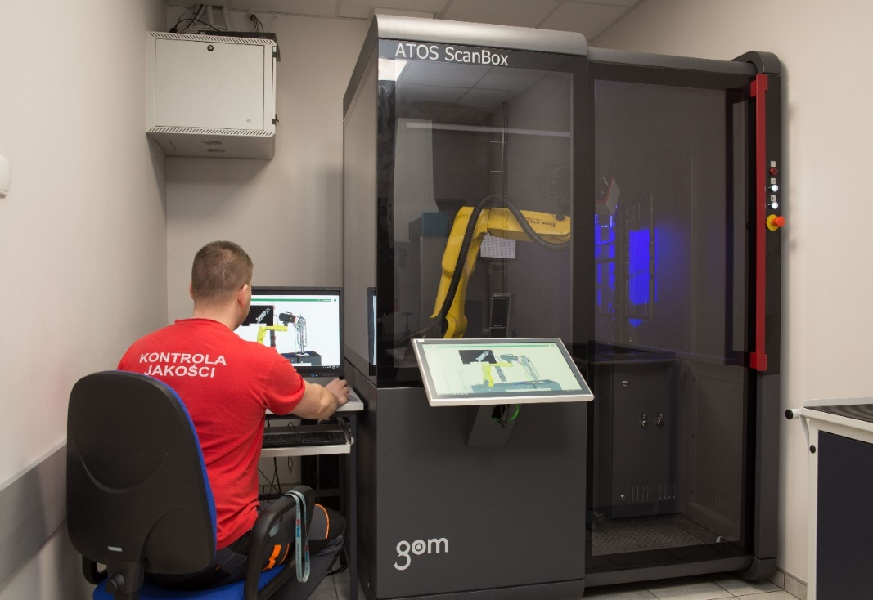
Quality Control Department
Atos Scanbox Series 4 – optical 3D measurement.
Quick and precise measurements.
Detailed reports and assessments in 3D drawings.
Data analysis and graphical presentation.
ISO 9001:2015 and IATF 16949:2016

Slide 14
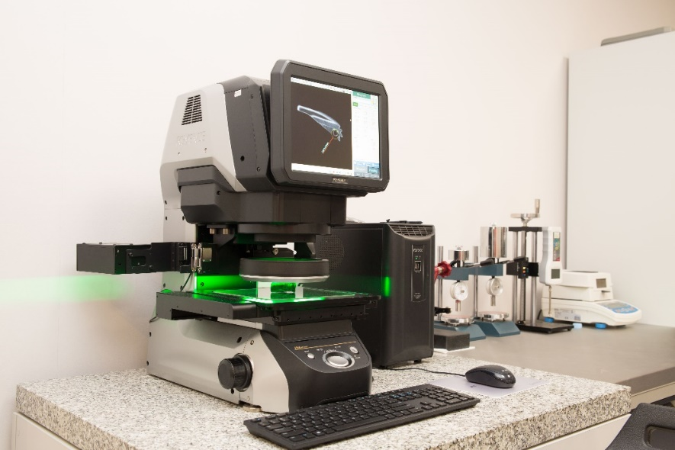
Quality Control Department
Image Dimension Measurement System using KEYENCE IM-700.
ISO 9001:2015 and IATF 16949:2016

Slide 15
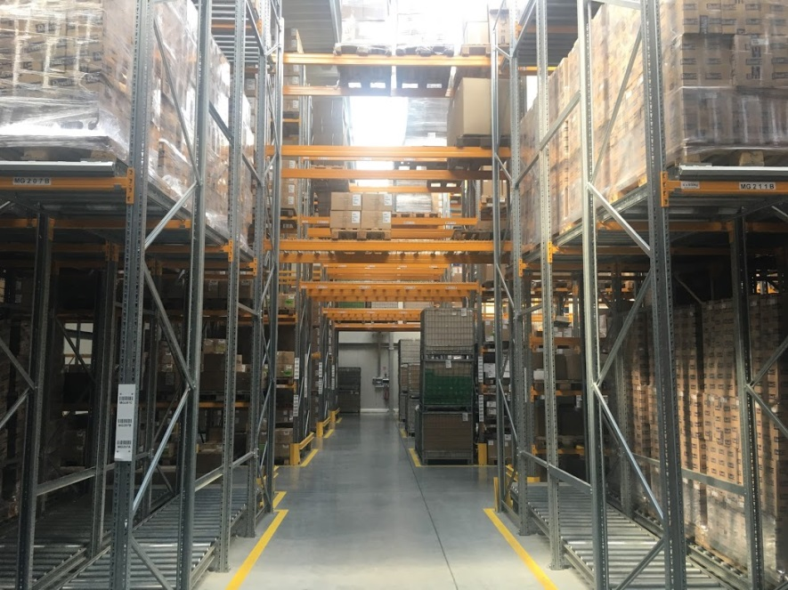
Logistics services
JIT deliveries.
Local and international transports.
High storage warehouse with a capacity of 1,300 pallet places.
Experience in international cooperation.
High standard of service.
ISO 9001:2015 and IATF 16949:2016

Slide 16
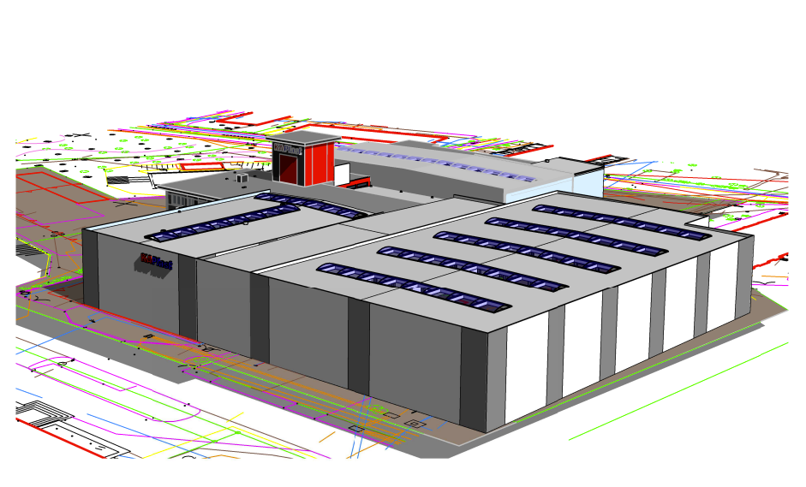
Investment plans for 2025-2026
Full use of existing infrastructure
New production hall
New warehouse
ISO 9001:2015 and IATF 16949:2016

Slide 17
Investments and implemented plans for the coming years:
New production hall with an area of 1700m2.
Increased storage capacity.
Assembly of details.
Ultrasonic welding.
Cleaning the injection mold cooling system.
Development of the maintenance department.
Injection analysis using CadMould 3D software.
Development of the engineering and technical department + staff development.
ISO 9001:2015 and IATF 16949:2016

Slide 18
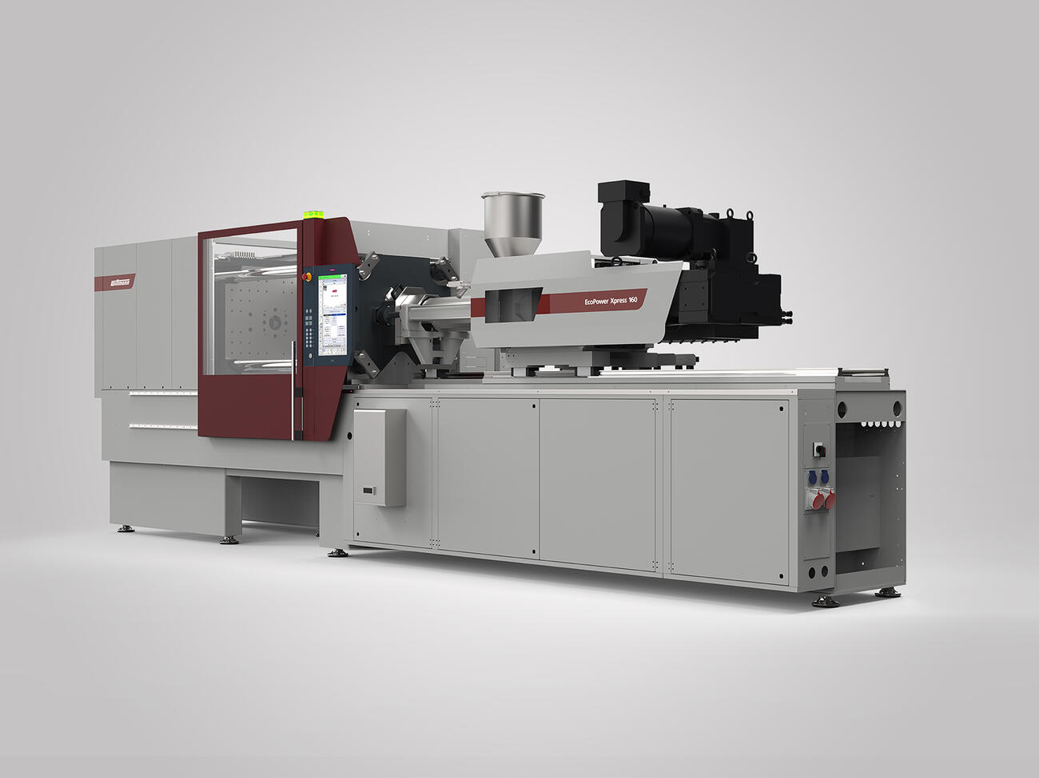

New Machine W120T
New production cell. Wittman injection molding machine with a clamping force of 120T equipped with peripheral devices, a robot and a safety cage.
ISO 9001:2015 and IATF 16949:2016

Slide 19
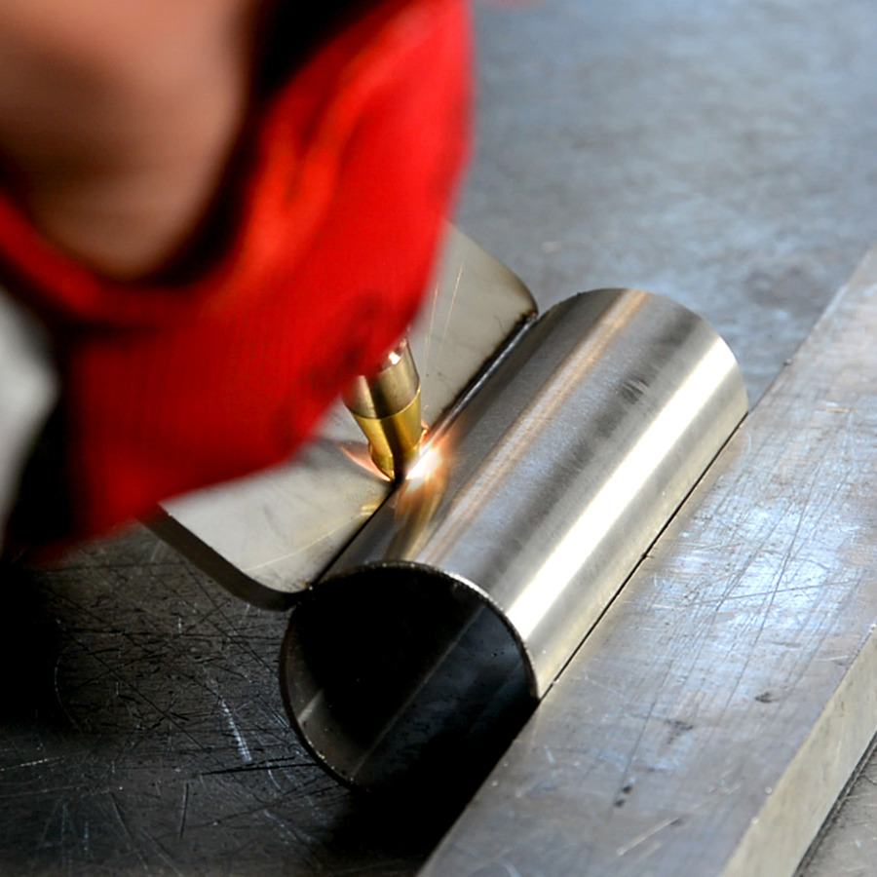
Laser Welder - Technigo
Advantages:
high welding speed
small area of ​​heat impact on the material
small deformation of the workpiece
welding without melting
no shrinkage cavities
repeatability of the process
possibility of welding very thin materials
no need to etch the weld
consumables for laser welding are cheaper and their service life is long
safe and more ecological
ISO 9001:2015 and IATF 16949:2016

Slide 20
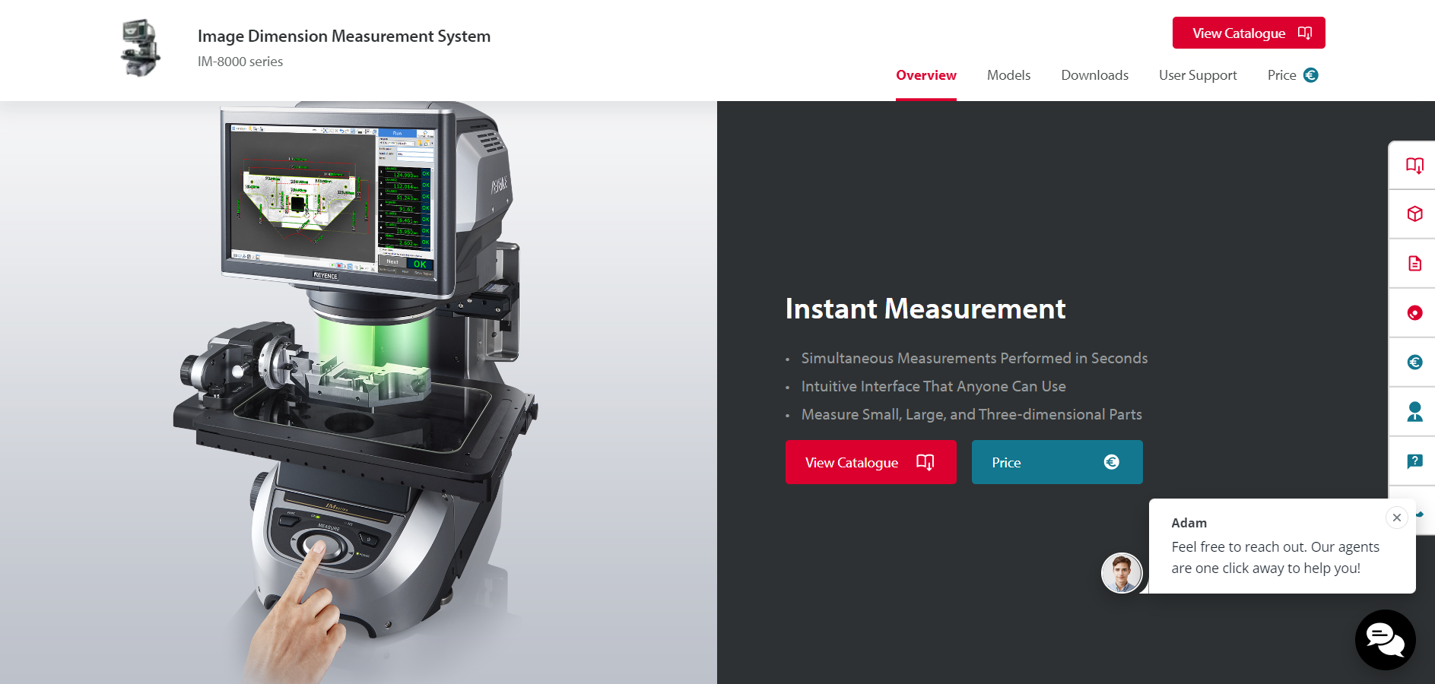
Keyence
Very high measurement accuracy on small details.
Spatial scan with higher accuracy than GOM.
ISO 9001:2015 and IATF 16949:2016

Slide 21
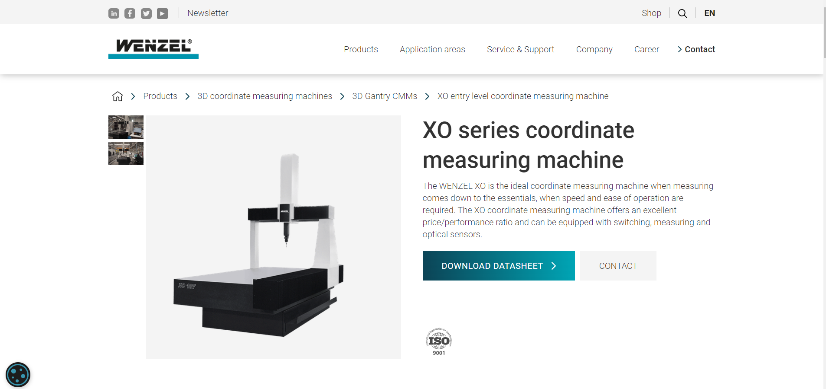
Wenzel Upgrade
Upgrade to the new software version.
Remote configuration of measurement programs.
Expanded measurement capabilities.
Improved utilization of the contact measurement machine. Compatible with GOM software
ISO 9001:2015 and IATF 16949:2016

Slide 22
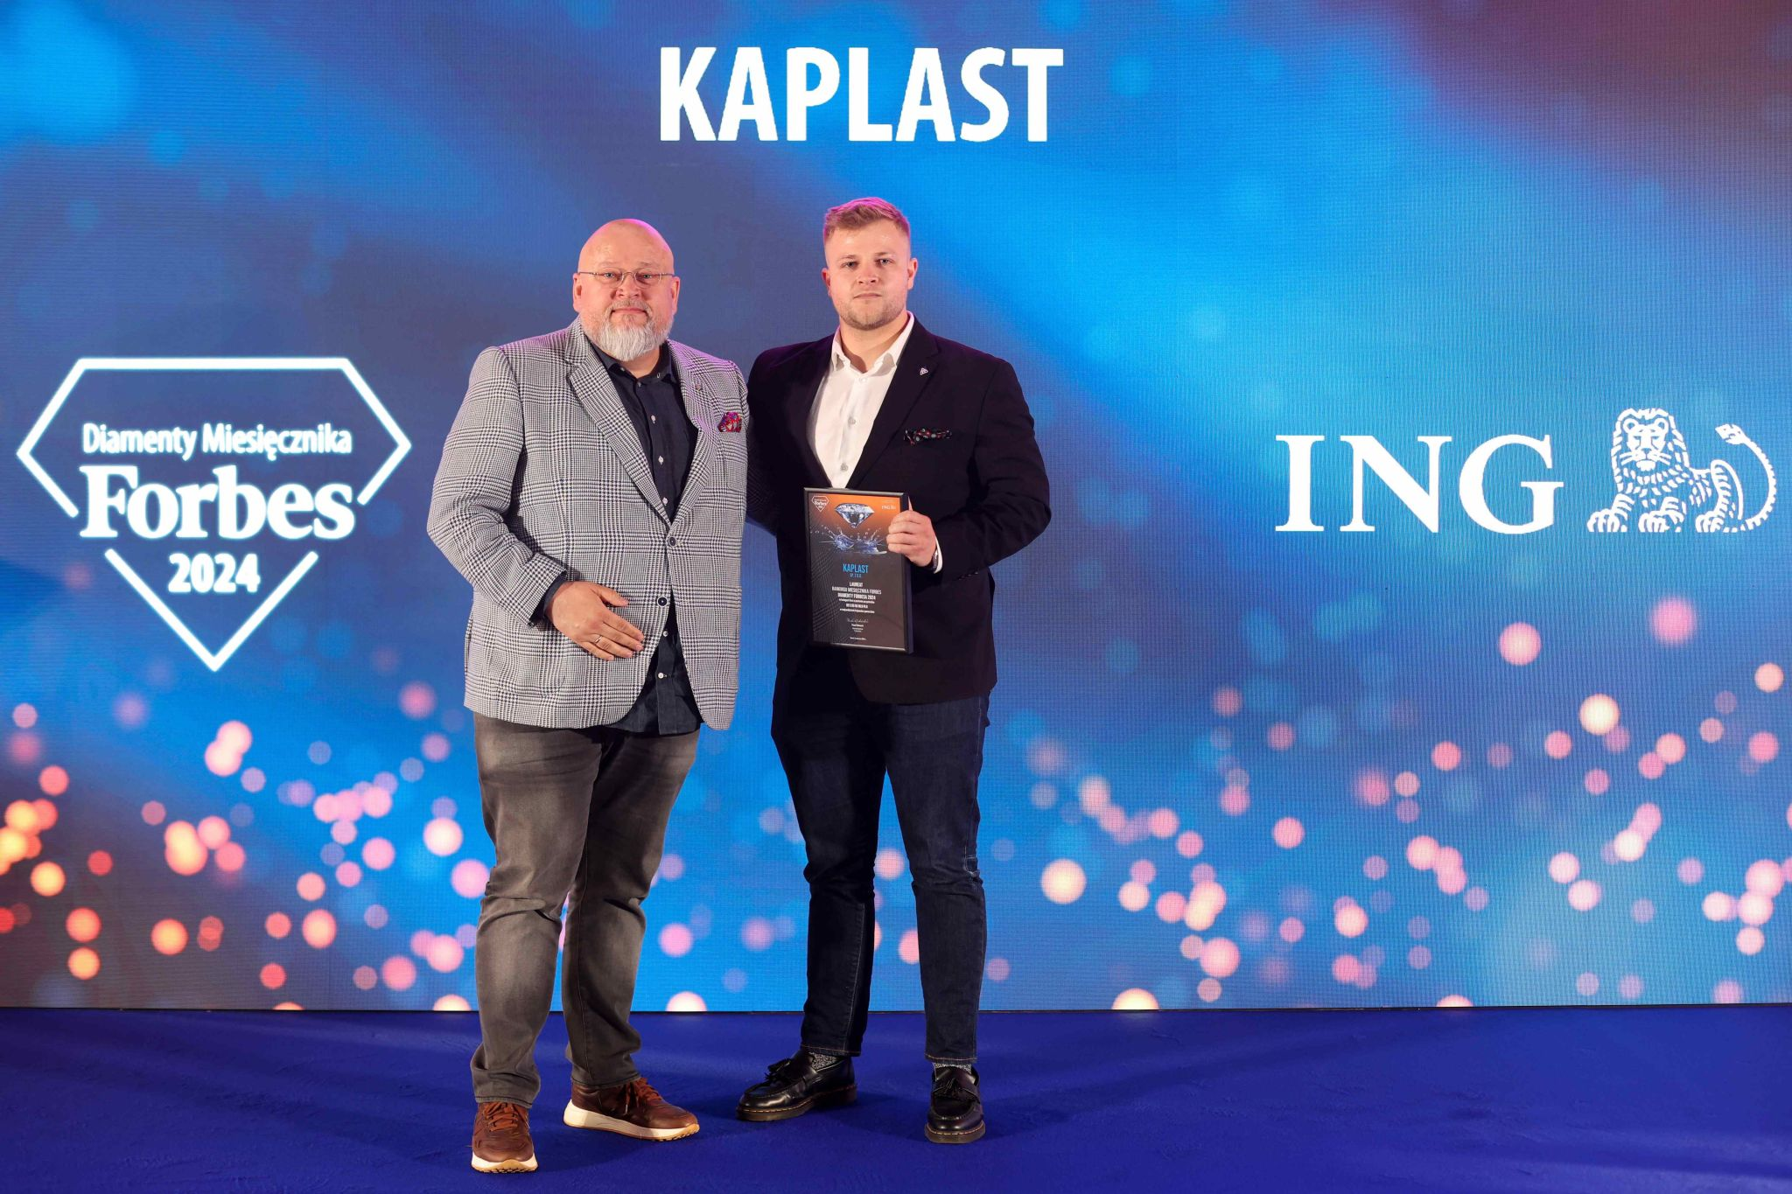
Awards
ISO 9001:2015 and IATF 16949:2016

